Slide 1



LOCAL WORKER HIRING AND MANAGEMENT SYSTEM USING ANDROID AND FIREBASE
PRESENTED BY,
GUIDED BY ,
DHANUSHKUMAR R (622522104006)
KEERTHIVASAN C (622522104022)
KISHORE G (622522204023)
NAGARAJ S (622522104031)
Mrs.M.MANIPRIYA.,M.E.,
ASSISTANT PROFESSOR ,
DEPARTMENT OF INFORMATION TECHNOLOGY,
SELVAM COLLEGE OF TECHNOLOGY

Slide 2
Introduction
Transforming Service Access
Mobile tech reshapes service access
The rise of mobile applications has revolutionized how services are accessed, enabling instant connections between clients and local workers.
Local workers still rely on personal contacts
Despite technological advancements, many local workers depend on personal networks for job opportunities, limiting
their reach.
Fragmented hiring process
Current hiring practices are disjointed, leading to inefficiencies and missed opportunities for both workers and clients.
Need for a unified digital platform
A centralized platform can streamline the hiring process, enhancing visibility and accessibility for local workers.

Slide 3
Abstract
Centralized Hiring and Communication
Android-Firebase centralized platform
This solution combines the power of Android for mobile accessibility with Firebase for backend support, creating a robust hiring environment.
Streamlined hiring & communication
The platform simplifies the interaction between clients and workers, fostering quicker hiring decisions and clearer communication.
Secure authentication, real-time DB
Utilizing Firebase's secure authentication and real-time database capabilities ensures data integrity and immediate updates.

Slide 4
Problem Definition
Challenges in Local Hiring
No central visibility for workers
Workers often lack a platform that provides them visibility to potential clients, restricting job opportunities.
Inefficient communication & scheduling
Current methods of communication are often slow and unreliable, leading to missed opportunities and scheduling conflicts.
Limited job reach beyond personal networks
Many workers are confined to their immediate circles, limiting their job prospects and potential earnings.

Slide 5
Project Objectives
Goals of the Initiative
Improve worker discoverability
By centralizing profiles, workers can be easily found by potential clients, enhancing job opportunities.
Accelerate hiring workflow
Streamlining the process reduces time-to-hire, benefiting both clients and workers.
Create digital job opportunities
The platform opens up new avenues for job postings that reach a wider audience than traditional methods.
Structure communication channels
Establishing clear communication pathways ensures effective interactions between clients and workers.

Slide 6
Scope of the Project
Features and Functionalities
Android app for client-worker matching
The application will utilize algorithms to effectively match clients with local
workers based on skills and availability.
Worker profile & skill management
Workers can create and update profiles showcasing their skills, increasing their chances of being hired.
Job request posting & tracking
Clients can post job requests and track their progress, enhancing transparency in the hiring process.

Slide 7
Literature Survey – Part 1
Insights from Existing Research
Online service marketplaces boost skilled-labor access
Research indicates that online platforms significantly increase access to skilled labor, facilitating better job matches.
Case studies of current platforms
Analyzing existing platforms provides insights into best practices and common pitfalls in the hiring landscape.

Slide 8
Literature Survey – Part 2
Technological Insights
Firebase for real-time sync
Firebase's architecture allows for real-time data updates, ensuring that all users have the latest information immediately.
Verification & digital-literacy hurdles
Challenges in verifying worker credentials and varying levels of digital literacy can impact user adoption and trust.

Slide 9
Existing System Analysis
Current Landscape Overview
Reliance on personal contacts & local agents
Workers often depend on their networks for job opportunities, limiting their reach and potential.
No central digital database
The absence of a unified database results in fragmented information and missed connections between workers and clients.
Manual, time-consuming search
Current hiring processes are often manual and inefficient, leading to delays in job placements.

Slide 10
Disadvantages of Existing System
Identified Gaps
Restricted reach beyond contacts
Workers are unable to connect with clients outside their immediate networks, limiting job opportunities.
Unverified skill information
Without a centralized platform, clients may struggle to verify the skills and qualifications of workers.
Unstable earnings for workers
Inconsistent job availability leads to unpredictable earnings, creating financial stress for workers.

Slide 11
Proposed System Overview
Innovative Solution
Kotlin-based Android app
The application will be developed using Kotlin, providing a modern and efficient coding environment for Android
development.
Real-time job posting & discovery
Users can post and discover jobs instantly, enhancing the hiring process's responsiveness.
Transparent worker profiles
Profiles will include verified skills and ratings, ensuring clients can make informed hiring decisions.

Slide 12
Advantages of Proposed System
Key Benefits
Faster hiring (quick selection)
Streamlined processes allow for quicker hiring decisions, benefiting both clients and workers.
Broader customer base
By expanding reach beyond personal networks, the platform connects a wider audience of clients to local workers.
Secure Firebase data handling
Utilizing Firebase ensures secure data management, protecting user information and maintaining trust.

Slide 13
System Requirements – Development Hardware
Hardware Specifications
CPU: Intel Core i5 or higher
A powerful CPU is essential for efficient development and testing of the application.
RAM: ≥12 GB
Sufficient RAM ensures smooth multitasking and performance during development.
Storage: 256 GB SSD or more
Fast storage solutions are critical for quick access to development resources and tools.

Slide 14
System Requirements – User Device
User Specifications
Android 8.0 (Oreo) or newer
The application will require a modern Android OS to support all features and functionalities.
RAM ≥ 4 GB
Adequate RAM is necessary for running the application smoothly without performance issues.
Internet ≥ 10 Mbps (Wi-Fi/4G)
A stable internet connection is required for real-time data synchronization and app functionality.

Slide 15
System Requirements – Software
Software Specifications
IDE: Android Studio
Android Studio will be used as the primary development environment for building the application.
Language: Kotlin
Kotlin will be the programming language of choice, known for its modern syntax and ease of use.
Backend: Firebase Cloud Services
Firebase will provide the backend infrastructure, ensuring scalability and real-time features.

Slide 16
Technology Stack – Kotlin
Programming Language Benefits
Modern Android language
Kotlin offers a contemporary approach to Android development, improving code clarity and maintainability.
Enhanced performance
Kotlin's efficiency allows for faster app performance and reduced load times, enhancing user experience.
Safety & null-ability
Kotlin's type system helps eliminate null pointer exceptions, improving code reliability and safety.

Slide 17
Technology Stack – Firebase Services
Backend Requirements
Authentication: Email/Password login
Firebase authentication will enable secure user logins, ensuring data protection and user privacy.
Firestore: NoSQL real-time DB
Firestore will serve as the application's database, allowing for real-time data synchronization and storage.

Slide 18
System Architecture (Block Diagram)
Connectivity Overview
Client ↔ Firebase
Clients will interact directly with Firebase for job postings and worker discovery, ensuring a seamless experience.
Worker ↔ Firebase
Workers will also connect with Firebase for receiving job alerts and managing their profiles in real-time.
Admin ↔ Firebase
Administrators will have access to Firebase for managing user data and overseeing transactions.
Real-time sync
All interactions will be synchronized in real-time, providing users with the most current information available.

Slide 19
Data Flow Diagram (DFD)
Process Overview
User registration → profile creation
New users will register, leading to the creation of their profiles within the system.
Job request → matching engine
Clients will submit job requests, which will be processed by the matching engine to find suitable workers.
Booking confirmation → notification
Once a booking is confirmed, users will receive instant notifications regarding job status.

Slide 20
Core Modules
Essential Features
User/Worker Registration
Facilitates easy sign-up processes for both clients and workers, enhancing accessibility.
Worker Discovery & Filtering
Users can easily search for and filter workers based on skills, availability, and ratings.
Booking Management
Manages the booking lifecycle, from job requests to confirmations and notifications.

Slide 21
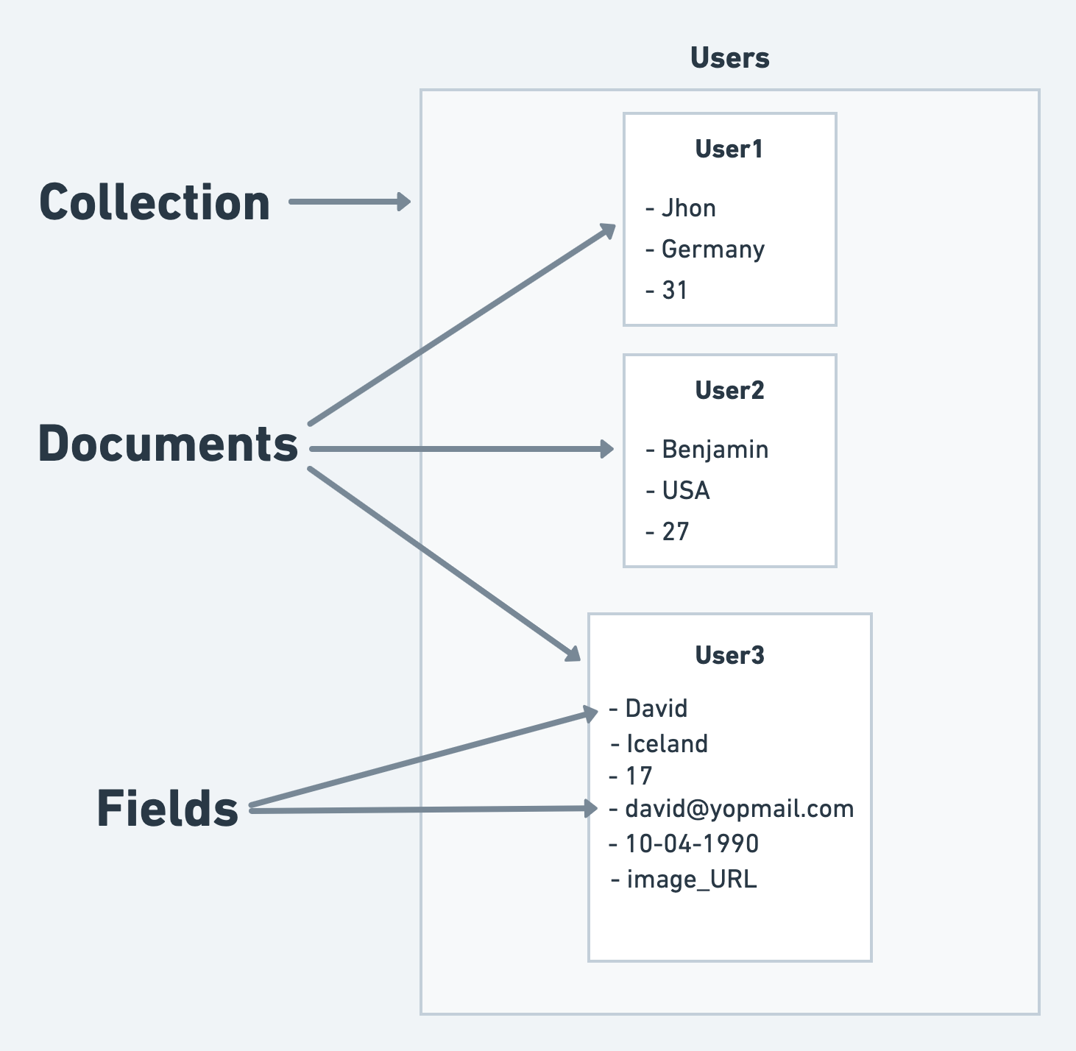
Database Design – Firestore Schema
Data Structure Overview
Collections: Users, WorkerProfiles, JobRequests
The database will consist of specific collections to streamline data management and retrieval.
Scalable NoSQL structure
The NoSQL design allows for scalability, accommodating growth in user data and interactions over time.

Slide 22
System Testing
Quality Assurance Processes
Unit Testing – individual features
Each feature will undergo rigorous testing to ensure functionality and reliability before integration.
Integration Testing – app ↔ Firebase
Testing will ensure seamless interaction between the app and Firebase, confirming real-time data synchronization.
UAT – real-user feedback
User acceptance testing will gather feedback from real users to refine and improve the application before launch.

Slide 23
Input & Output Design
Input:
Name, Email, Password
Worker details (skills, price, experience)
Job request details
Output:
Worker list
Profile details
Job status (Pending / Accepted / Completed)

Slide 24
Application Screenshots (Key Screens)
Visual Representation
Launch Screen
The initial screen users encounter when opening the app, setting the tone for the user experience.
Role Selection
Allows users to select their role (client or worker), tailoring the experience to their needs.
Worker Discovery
Feature enabling clients to search and view available workers based on skills and ratings.

Slide 25
Conclusion
Reliable platform for local services
Our system provides a dependable infrastructure for connecting clients with local workers, enhancing service delivery.
Creates employment & service access
The platform will generate job opportunities for local workers, contributing to economic growth.
Scalable cloud-based solution
Leveraging cloud technology ensures that our platform can grow and adapt to user needs over time.

Slide 26
Thank You

